Slide 1
Stock market prediction system
Group no 3
Group Members:
Ria Garg (306016)
Ritika Jain (306019)
Harshali Bedmutha (306006)

Slide 2
INTRODUCTION
A stock market, equity market or share market is the aggregation of buyers and sellers (a loose network of economic transactions, not a physical facility or discrete entity) of stocks (also called shares), which represent ownership claims on businesses; these may include securities listed on a public stock exchange as well as those only traded privately.
Stock market prediction is the act of trying to determine the future value of a company stock or other financial instrument traded on an exchange.
The successful prediction of a stock's future price could yield significant profit.

Slide 3
About the project
Aim: To predict the future of stock market based on the past and present data.
Description:
Prediction of stock market price is one of the most important issues in finance. Many researchers have been given their idea how to forecast the market price in order to make gain using different techniques.
One common approach is to use Machine Learning algorithms to learn from price historic data to predict future prices.
We aim at applying different predictive algorithms to analyse the stock market data for future trend prediction.
We consider parameters like Open, High, Low, Close, Volume etc. for accurate predictions.

Slide 4
Algorithms
Artificial Neural Network(ANN)
Support Vector Machine(SVM)
Linear Regression
LSTM(Long Short Term Memory)

Slide 5
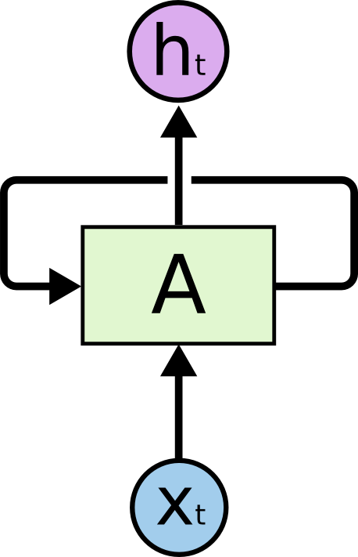
Recurrent Neural Networks
Humans don’t start their thinking from scratch every second. As you read this essay, you understand each word based on your understanding of previous words. You don’t throw everything away and start thinking from scratch again. Your thoughts have persistence.
Traditional neural networks can’t do this, and it seems like a major shortcoming. For example, imagine you want to classify what kind of event is happening at every point in a movie. It’s unclear how a traditional neural network could use its reasoning about previous events in the film to inform later ones.
Recurrent neural networks address this issue. They are networks with loops in them, allowing information to persist.
Recurrent Neural Networks have loops.

Slide 6
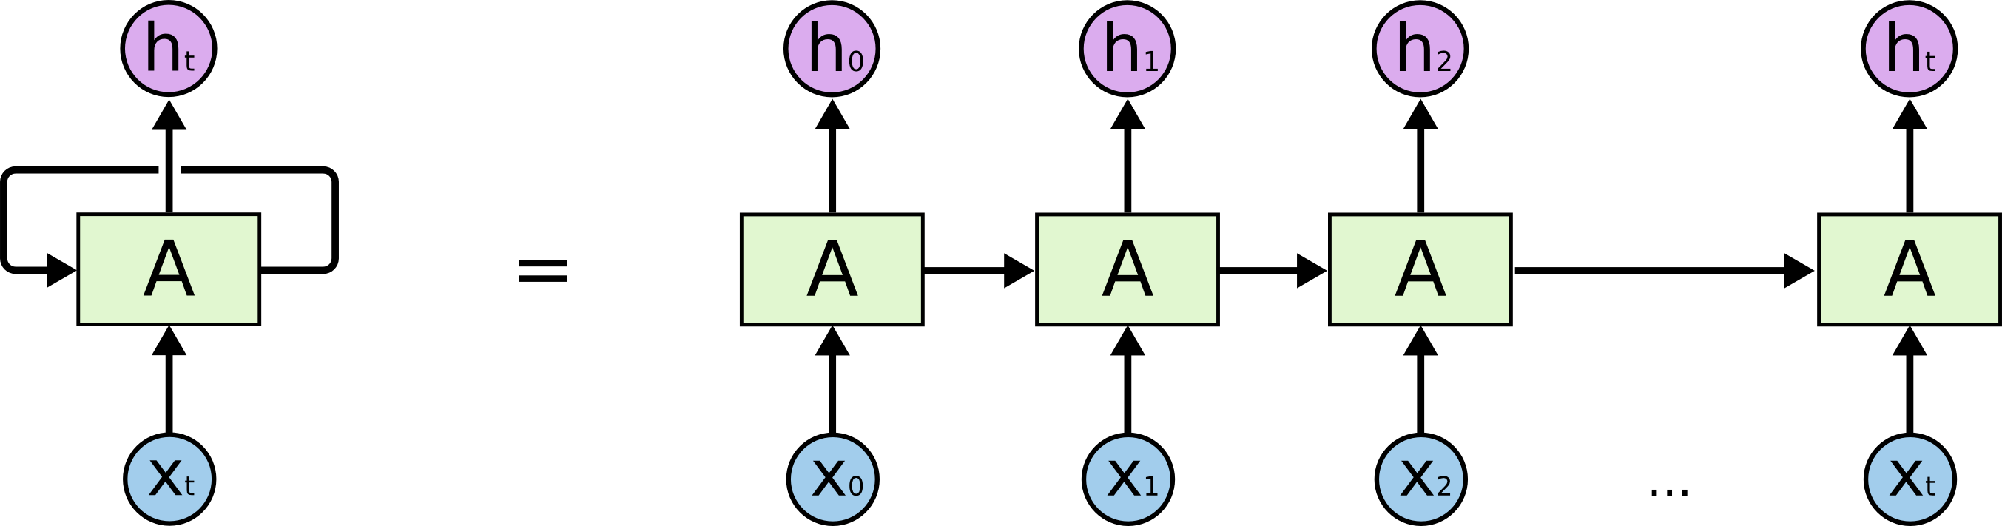
A recurrent neural network can be thought of as multiple copies of the same network, each passing a message to a successor. Consider what happens if we unroll the loop
It’s entirely possible for the gap between the relevant information and the point where it is needed to become very large.
Unfortunately, as that gap grows, RNNs become unable to learn to connect the information.
An unrolled recurrent neural network.

Slide 7
LSTM Networks
Long Short Term Memory networks – usually just called “LSTMs” – are a special kind of RNN, capable of learning long-term dependencies.
LSTMs are explicitly designed to avoid the long-term dependency problem. Remembering information for long periods of time is practically their default behaviour, not something they struggle to learn!
The LSTM does have the ability to remove or add information to the cell state, carefully regulated by structures called gates.
Gates are a way to optionally let information through

Slide 8
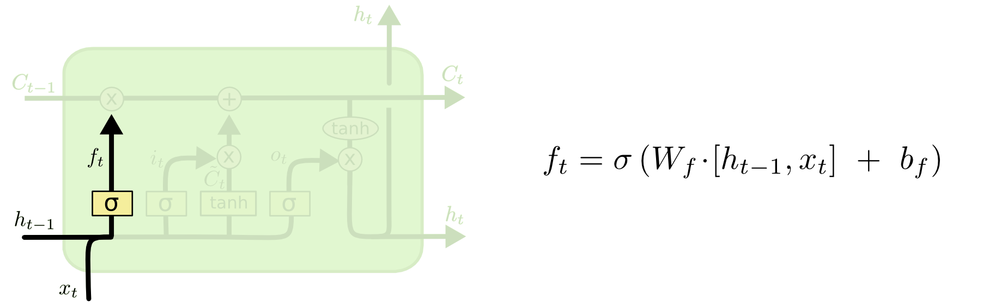
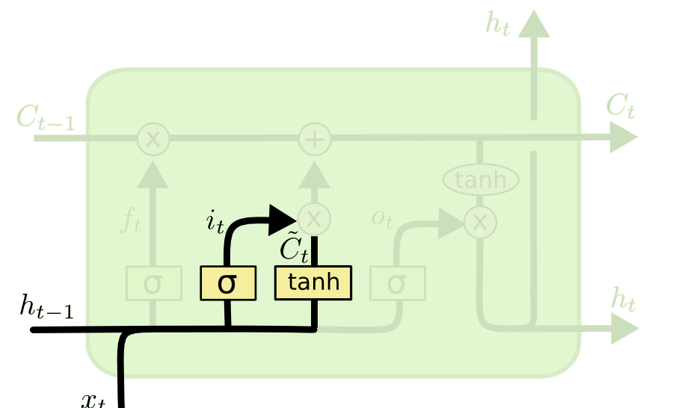
The first step in our LSTM is to decide what information we’re going to throw away from the cell state. This decision is made by a sigmoid layer called the “forget gate layer.”
The next step is to decide what new information we’re going to store in the cell state. This has two parts. First, a sigmoid layer called the “input gate layer” decides which values we’ll update. Next, a tanh layer creates a vector of new candidate values, [Math Processing Error], that could be added to the state. In the next step, we’ll combine these two to create an update to the state.
It’s now time to update the old cell state, into the new cell state . The previous steps already decided what to do, we just need to actually do it.
We multiply the old state by [Math Processing Error], forgetting the things we decided to forget earlier.

Slide 9
LSTM in stock market prediction
EXAMPLE
We take as input a sequence of price data for 1000 stocks
Each timepoint in the sequence is a snapshot of the market. Our input is a list of 4000 numbers. We use an embedding layer to represent the key information in just 300 numbers.
Now we have a sequence of embeddings of the market. We put those into a stack of LSTMs, timestep by timestep. The LSTMs remember things from the previous steps and that influences how they process the current one.
We pass the output of the first layer of LSTMs into another layer. These guys also remember and they learn higher level abstractions of the information we put in.
Finally, we take the output from all of the LSTMs and “squish them” so that our sequence of market information turns into a sequence of probabilities. The probability in question is “How likely is the VIX to go up 1% in the next 5 minutes without going down 0.5%”

